Slide 1


Flutter on the Web in 2019
<p> How well does it work? </p>
Jeroen Meijer (Jay)
Flutter & Dart GDE
@jfkdev

Slide 2
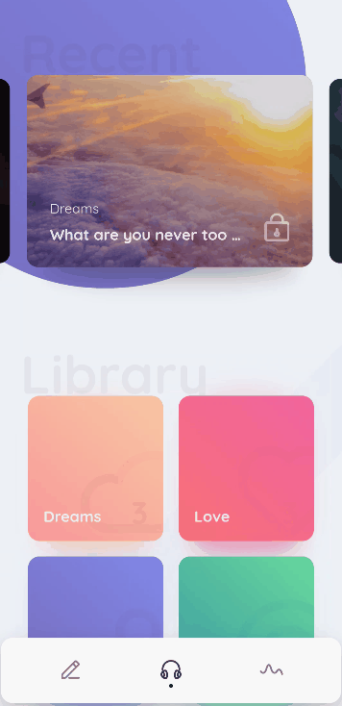
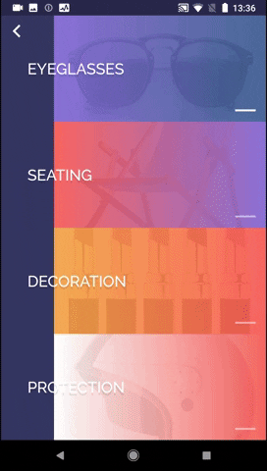
Beautiful apps in record time.
Flutter
An open source cross-platform portable UI toolkit.
Compiles to machine code.
Custom graphics through with the Skia rendering engine.

Slide 3
import 'package:flutter/material.dart';
void main() => runApp(MyApp());
class MyApp extends StatelessWidget {
@override
Widget build(BuildContext context) {
return MaterialApp(
title: 'Welcome to Flutter',
home: Scaffold(
appBar: AppBar(
title: Text('Welcome to Flutter'),
),
body: Center(
child: Text('Hello World'),
),
),
);
}
}

Slide 4
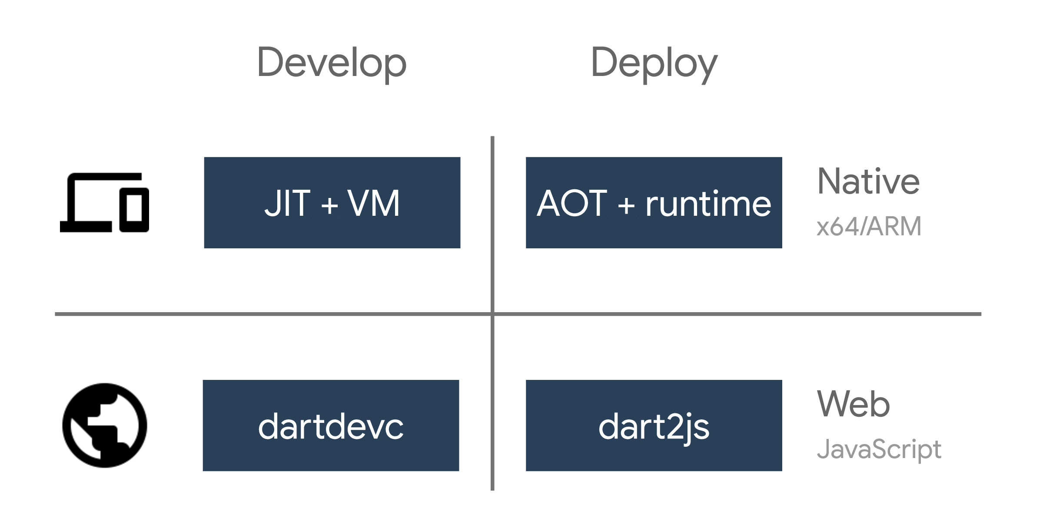
Dart
General purpose language.
Familiar syntax.
Allows for Hot Reload.
*
* will probably be important later

Slide 5
Flutter for Web
(Hummingbird)

Slide 6
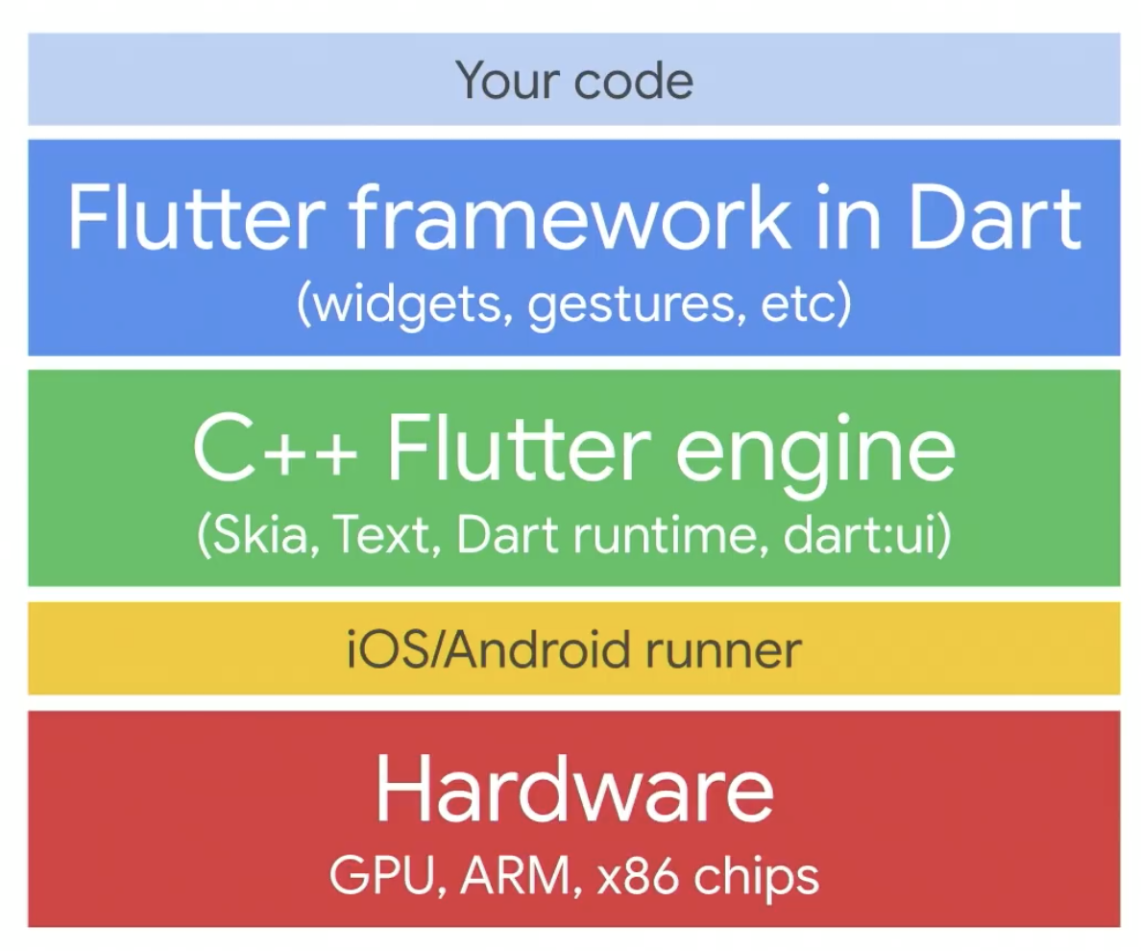
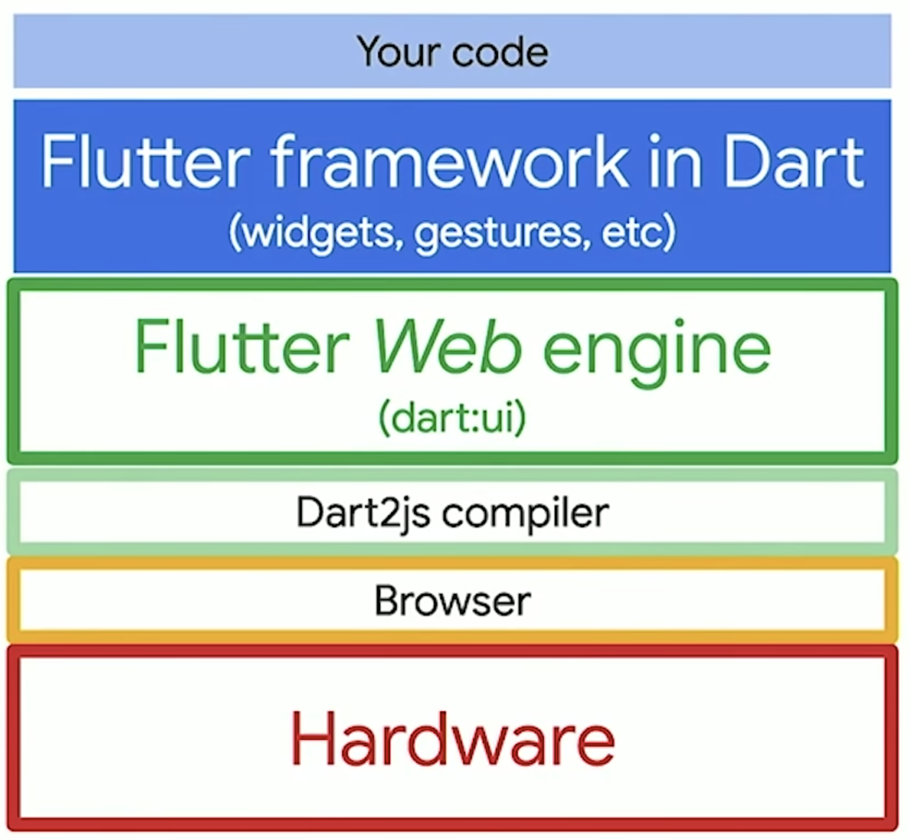
Under the Hood

Slide 7
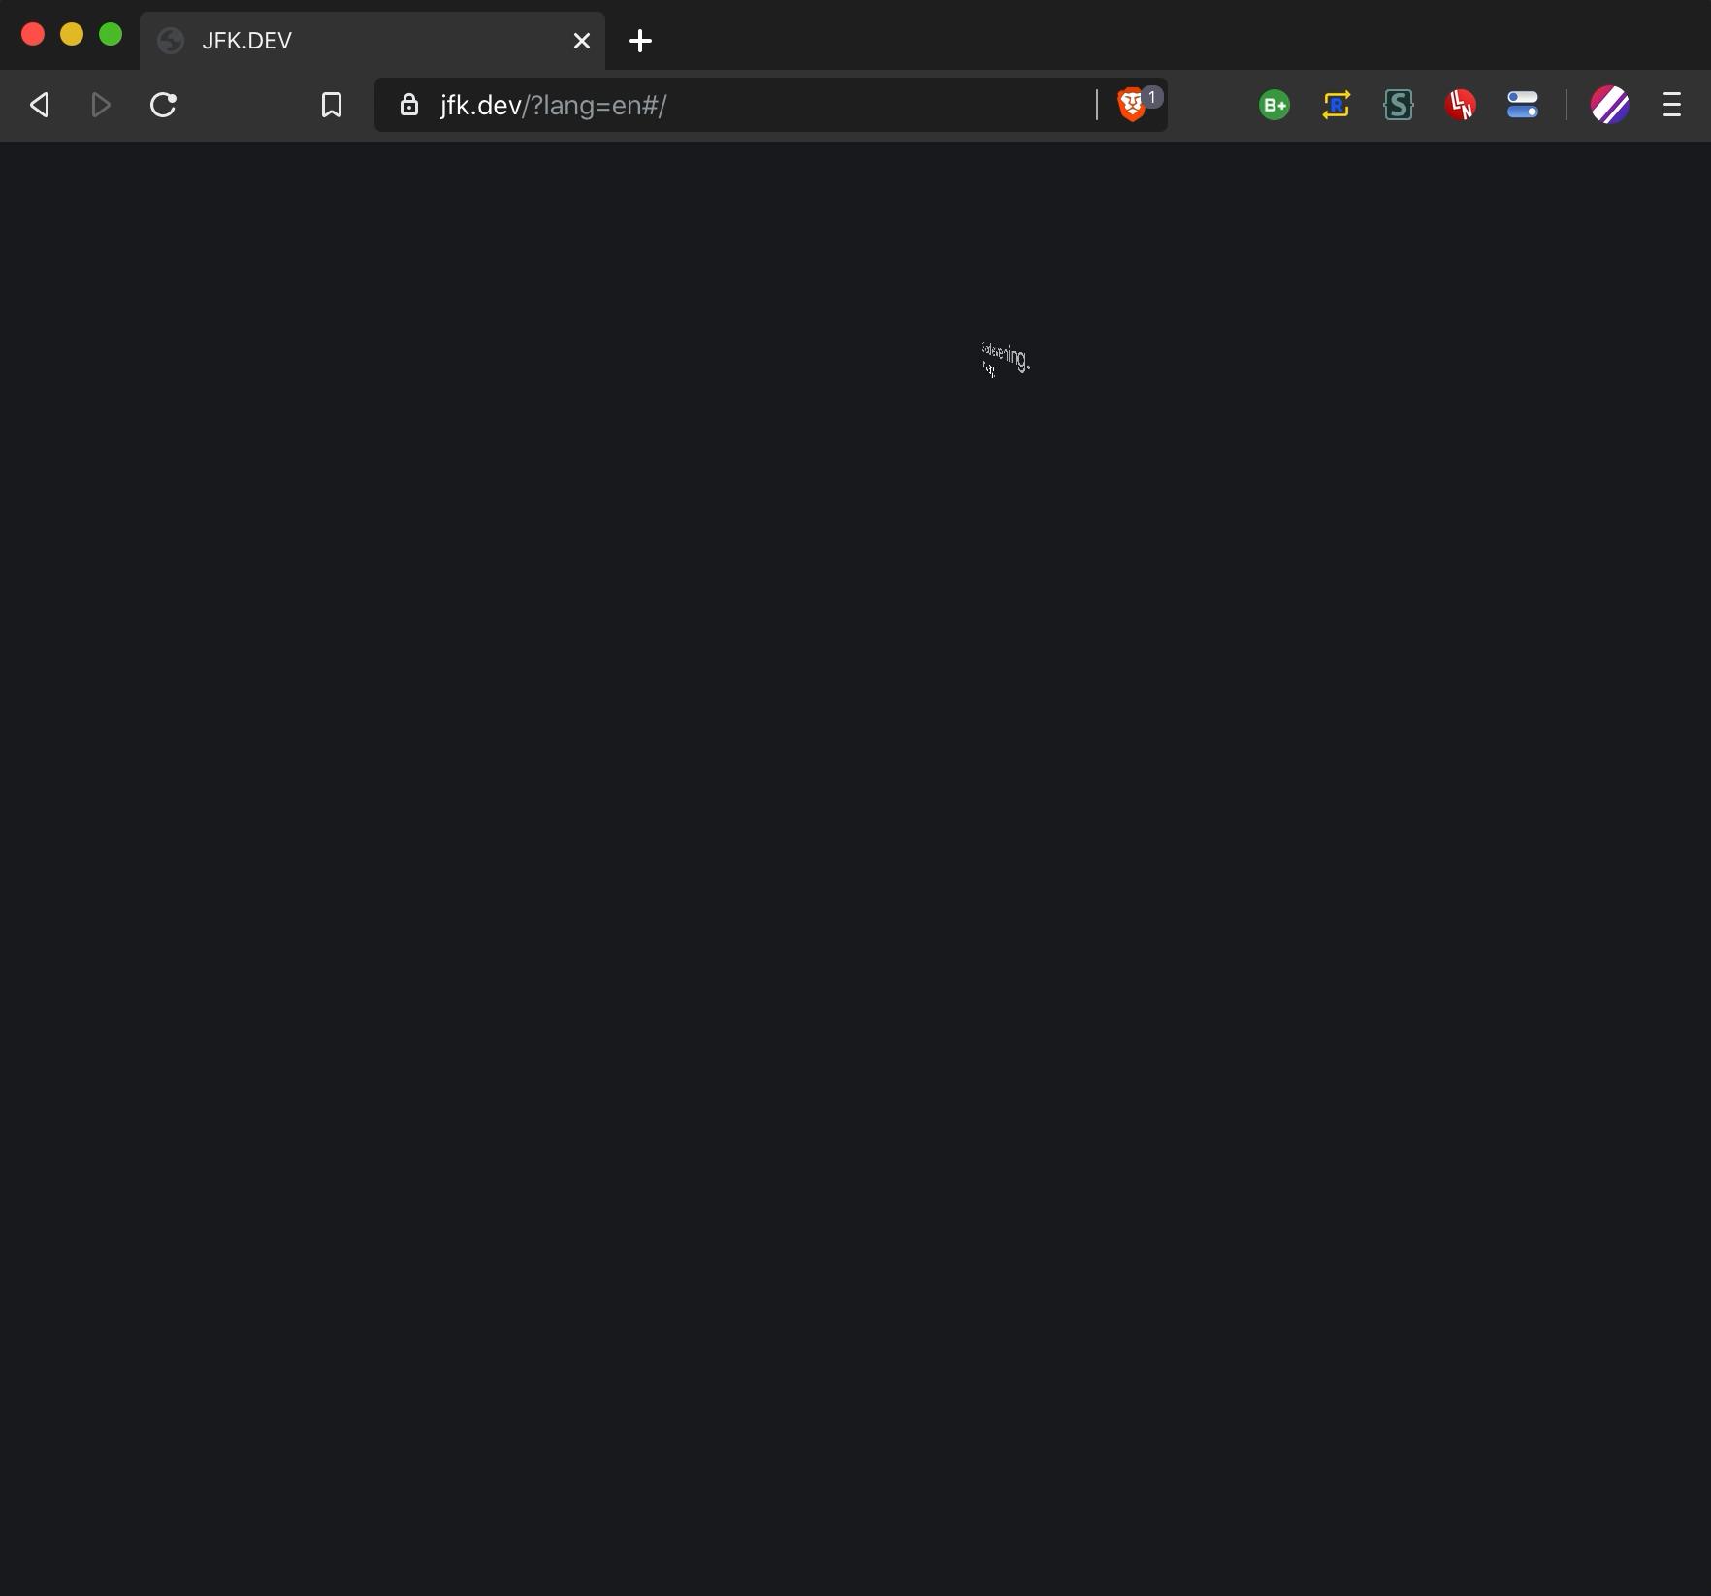
Does it work?
Yes.
Mostly.
https://jfk.dev

Slide 8
Limitations
Still in technical preview.
Flutter framework in Dart is fully supported.
Performance not as good as on mobile.
Pure Dart packages will mostly work.
Most plugins aren’t updated yet (but will be soon).
Glitches might occur in rendering (workarounds possible).

Slide 9
Progress
Everything is open source
Check out https://github.com/flutter/flutter

Slide 10
Final Notes & Resources
“There’s a widget for that!”
https://flutter.dev
https://fluttercommunity.dev/github

Slide 11

Thank You!
Slides and code available at https://jfk.dev/talks
Jeroen Meijer (Jay)
Flutter & Dart GDE
@jfkdev
@jeroen-meijer
https://jfk.dev

